Slide 1

Generating and Implementing CNN Models to Detect ASL Numbers
Justin Caringal
Truman State University
Kirksville, Missouri, USA

Slide 2

Introduction
Artificial intelligence
Leverage resources

Slide 3











Problem
Detect and classify ASL numbers 0-9

Slide 4
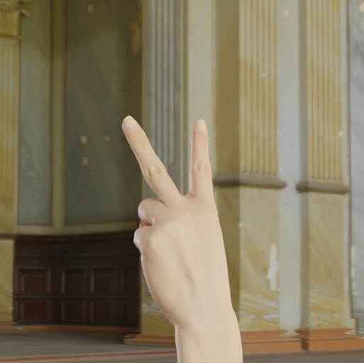
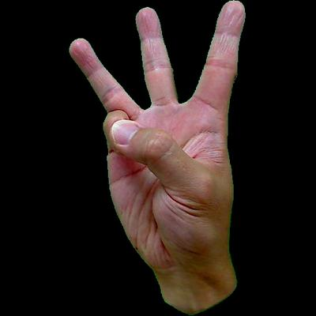
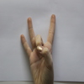
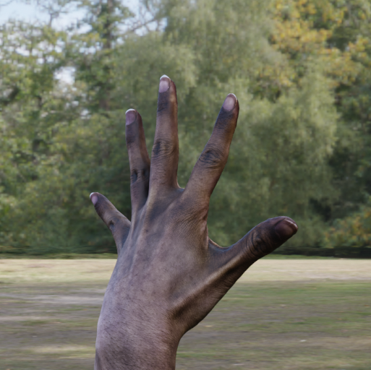
Dataset
Detect and classify ASL numbers 0-9
11,762 images

Slide 5
Basics of Deep Convolutional Q-Learning

Slide 6

Q-Learning
State (Q-value)
Reward (Temporal Difference)
Action (Bellman’s equation)

Slide 7
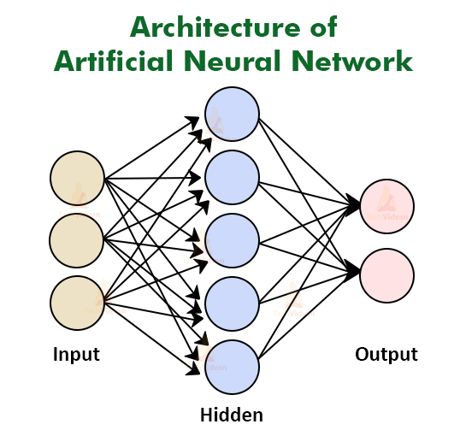
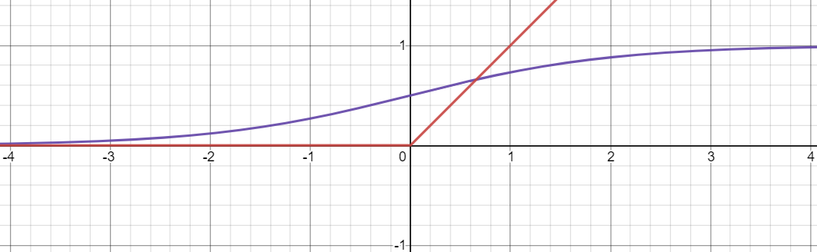

Deep Convolution
Deep
Neural Network
Memory
Layers
Convolution
Max Pooling

Slide 8
Solution

Slide 9
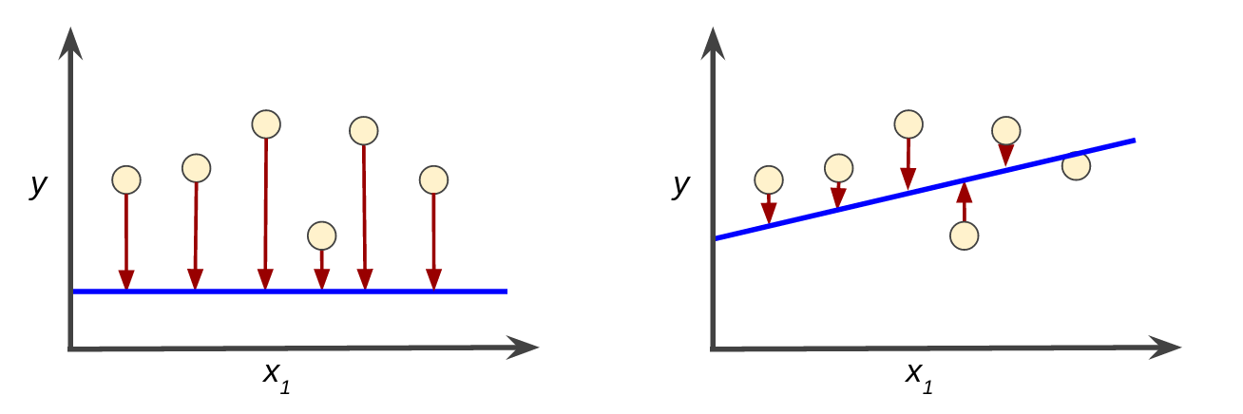
Model Metrics
Validation Accuracy
Validation Loss
Testing Accuracy
Testing Loss

Slide 10
Early Model GeneratioN
2,062 images (Mavi dataset)
1,962 training, 100 validation
512×512 pixels
Various layers & parameters tested
32×64×32 Conv2D (3×3)
2×2 MaxPooling2D
Dense
Dropout
Early Stopping callback

Slide 11
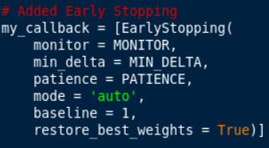
Early Stopping
Measures improvements
Stops if no improvement within n epochs

Slide 12
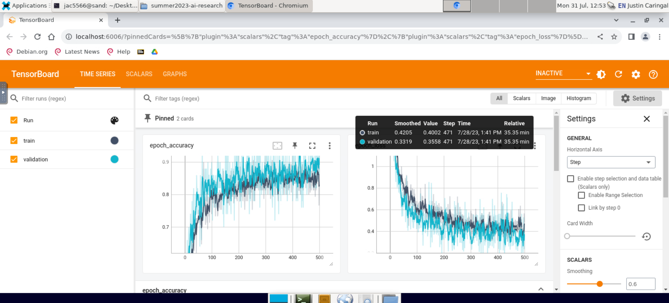
Various IMprovements
11,762 images (Mavi, Thakur, Lexset), 224×224
8,712 training, 2,905 validation, and 145 testing
Elapsed time
Discord bot integration
Introduction of testing statistics
Callbacks
CSVLogger
LearningRateScheduler
TensorBoard

Slide 13
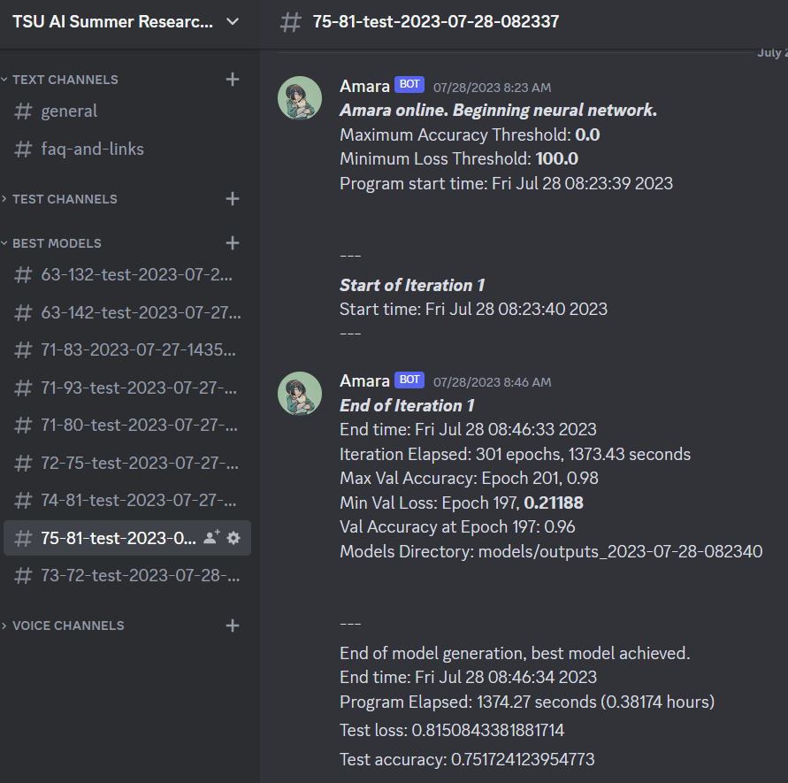
discord.py
Data collection
Better organization
Information dispersal
Automatic channel generation
One-click execution

Slide 14
Tensorflow Model Zoo
Pre-trained models
MobileNetv2
Trained on ImageNet
Freezing layers
Had little effect
Connected by GlobalAveragePooling2D
+10% accuracy, halved loss
Other models not tested as of writing
Ex. Resnet50

Slide 15
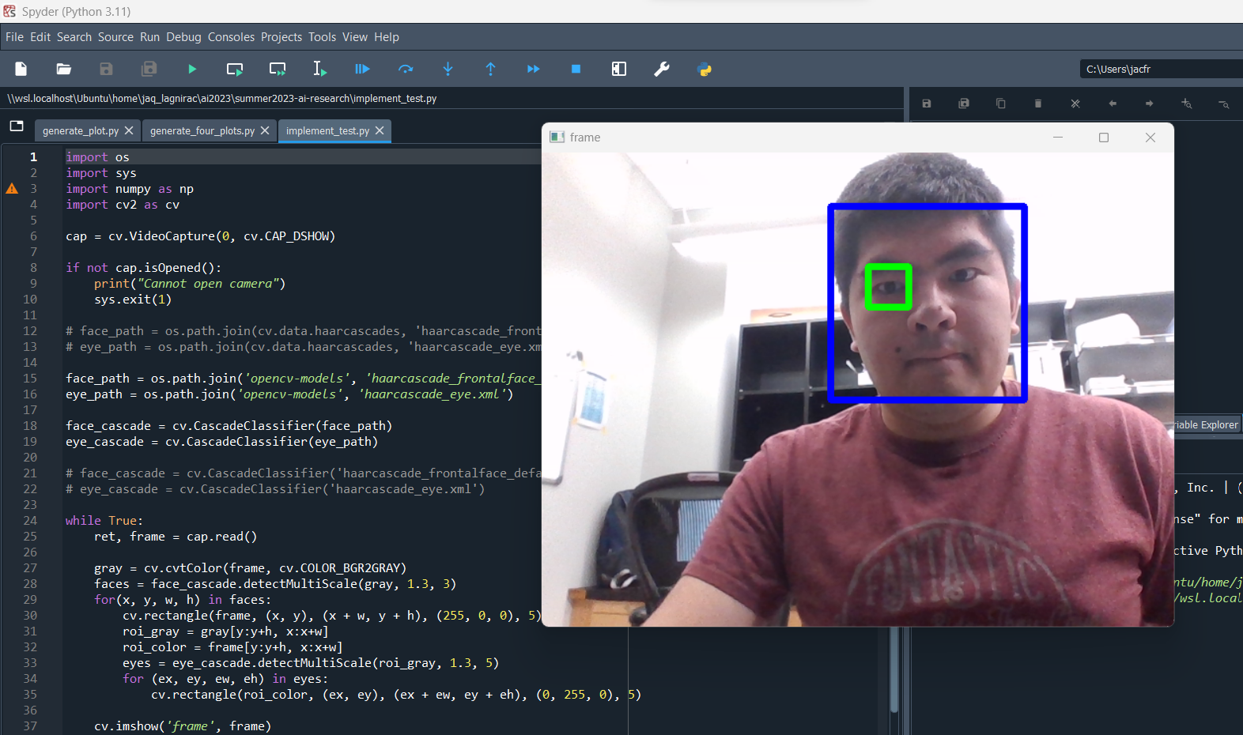
OpenCv
Computer vision framework
Haar Cascade Classifier
Need to connect generated model

Slide 16
data

Slide 17
Data Collected
Model | Code | Val. Acc. (%) | Val. Loss (%) | Test Acc. (%) | Test Loss (%) | Elapsed (hrs.)
C/BFS | 20-131023 | 94 | 16.1 | 60 | 140.3 | 2.67
C/BFS | 20-160248 | 94 | 16.2 | 48.3 | 161.3 | 1.77
C/BFS | 20-182231 | 90 | 20.7 | 63.4 | 132.7 | 1.53
C/BFS | 25-113027 | 100 | 3.9 | 62.1 | 128.9 | 1.55
C/BFS | 26-192442 | 98 | 13.9 | 46.9 | 203.1 | 1.35
C/BFS | 27-101838 | 96 | 8.8 | 63.4 | 142.5 | 1.19
MNv2 | 27-143535 | 94 | 32 | 71.7 | 83.5 | 0.25
MNv2 | 27-154003 | 94 | 32.9 | 71.7 | 93 | 0.17
MNv2 | 27-162115 | 98 | 19 | 71 | 80 | 0.25
MNv2 | 27-164541 | 94 | 20.1 | 72.4 | 75.6 | 0.32
MNv2 | 27-215322 | 100 | 1.4 | 74.5 | 81.2 | 0.36
MNv2 | 28-082337 | 96 | 21.2 | 75.2 | 81.5 | 0.38
MNv2 | 28-110102 | 96 | 20.7 | 73.1 | 72.6 | 0.35
C/BFS - Custom/Built-From-Scratch
MNv2 - MobileNetv2
Percents rounded to nearest tenth, hours rounded to nearest hundredth

Slide 18
Conclusion
Problem researched
Solution developed
Added to the workflow pipeline
Room for improvements

Slide 19
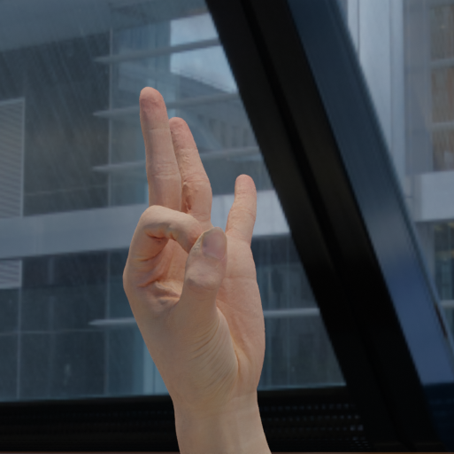


Future Directions
Full OpenCV Implementation
Script/Tool Suite
Configuration Files

Slide 20
Acknowledgements
Dr. Ruthie Halma
Dr. Don Bindner
Sam Myers

Slide 21

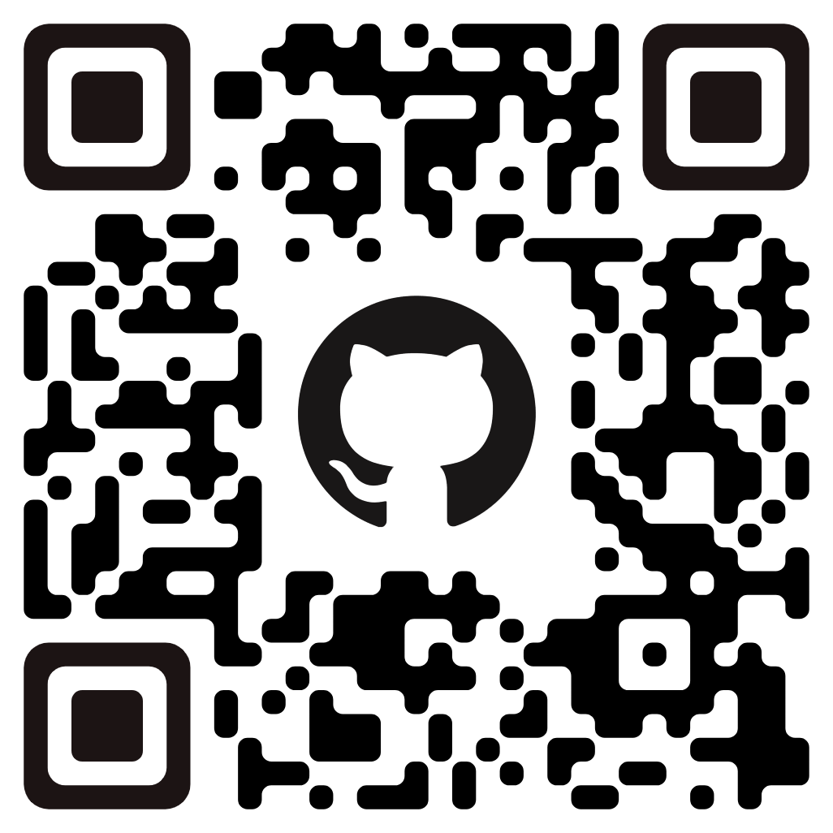
For more information:
Discord
Github
Access Discord server with outputs
Visit Github repository for full commit tree

Slide 22


